Slide 1


your ideal global partner for energy solutions
stored energy solutions for a demanding world

Slide 2

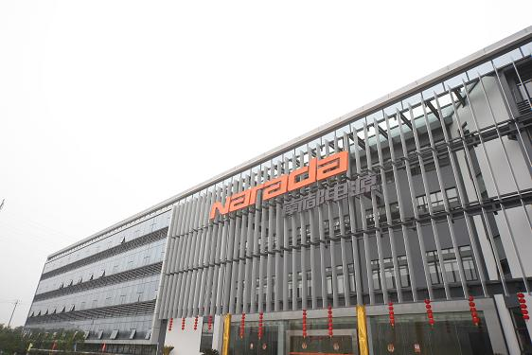
Who we are? The Background
Narada Holdings
Property
& Hotels
Civil
Engineering
Network
Cabling
Financial
Services
Chemical
Power
Industry
http://www.naradafoundation.org
Power Source Co., Ltd.

Slide 3


Who we are? An organization with distinct culture
Distinct culture
  A complete power solution provider
Vision
  To be a respected global player for the industry of
  stored energy solutions.
Value
Create value for customers and win together
with customers

Slide 4

Who we are? The History
1994  Establishment
1999  Second production center in Ningbo
2000  Narada Licom Power Technologies Co., Ltd.
2005  Narada Asia Pacific Pte. Ltd.
2006  Narada Europe (UK) Ltd.
2009  Lin’an new plant
2010  Listed company
2011  Acquisition of new production bases

Slide 5
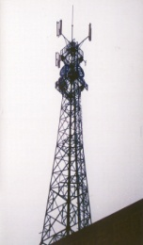
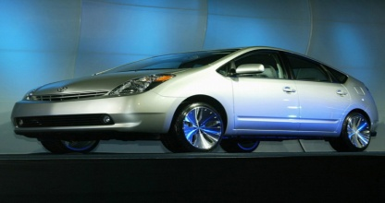
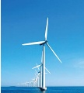
Strategy of Narada
To be whole solution provider in Telecom, motive power and energy storage field.
Telecom
Motive power
Energy storage
To be globally leading total solution provider for Telecom backup power, energy storage power, motive power and new energy resource application field.
5

Slide 6
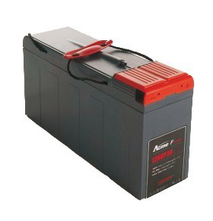
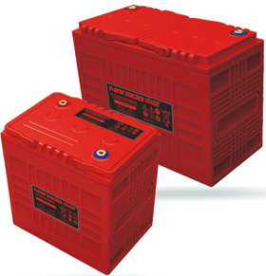
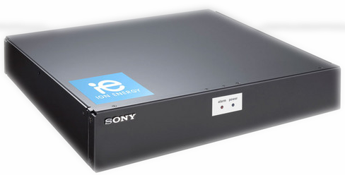
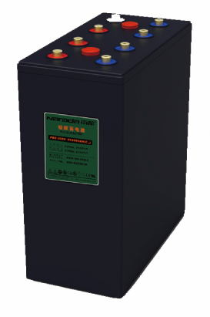
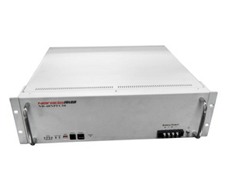
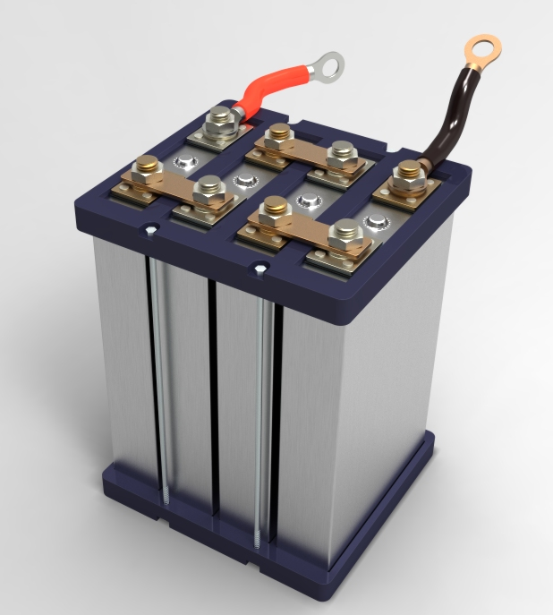
What we can do
Telecom
Motive power
Energy storage
Notes:
6
换锂电图片

Slide 7






Wide range products&Capacity
  Technology:
  AGM / Polymer Gel/ Tubular Gel VRLA
VRLA
Production Capacity of 17 million KVAH
lithium-ion
LiFePO4
Production Capacity of 1.20 GWh/year
Will extent to 1320MWH
LiFePO4
LiFePO₄ Batteries
7
Notes:
7

Slide 8


Leading position in R&D ability
Top one brand in China
Largest manufacture capacity for telecom battery in China
Products has exported to more than 100 countries
Top supplier in China telecom Industry
Annual turnover for overseas more than 120Million USD
Rich experience in overseas respected customers
The revenue of 2012 estimated to be 450million US Dollar
The revenue of 2012 estimated to be 450million US Dollar
The revenue of 2012 estimated to be 450million US Dollar

Slide 9

Wide range products
  Technology:
  AGM / Polymer Gel/ Tubular Gel VRLA
  Product range
  - Front and top terminal (12V,6V)
  - Large single cells up to 3000Ah(2V)
  Application
  Telecoms, UPS, Utilities, Rail and more
Standards Compliant:
IEC60896
BS6290
ROHS compliant

Slide 10
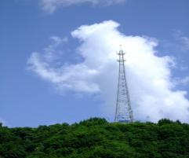
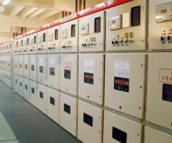
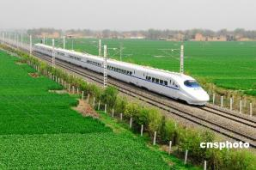
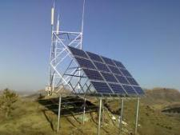
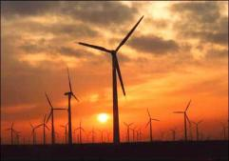
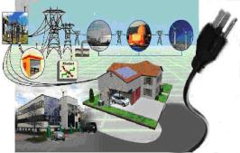
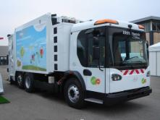
Product Application
Telecom
Storage Energy
Railway
Solar
Wind
Smart Grid
EV
10

Slide 11
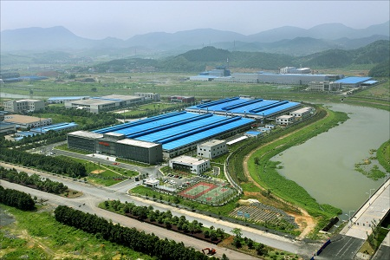
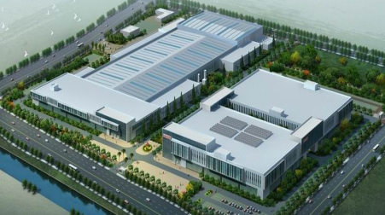
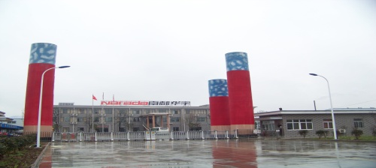
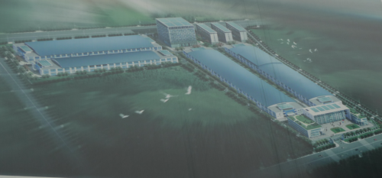
The largest Manufacturer of
industrial batteries in Asia
Established
Y2006
Lin An Plant
Capacity: 3.5M KVAH VRLA
Area: 115K m2
Established
Y1997
Capacity:120MWh Lithium
Area: 60K m2
Lin Ping Plant Ⅰ
Lin Ping Plant Ⅱ
(Under construction)
Established
Y2013
Capacity: 1200MWh Lithium
3M KVAH VRLA
Area: 170K m2
Acquisition
Y2011
Capacity: 14.4 million sets plates + 8 million VRLA 700K KVAH
Area: 110K m2
An Hui Plant
Acquisition
Y2011
Capacity: 2.5M KVAH VRLA battery + 320MWh Lithium
Area: 110K m2
Cheng Du Plant
Notes:
11
11
11
11
锂电突出（颜色），重点介绍新基地情况，投资情况，（颜色不用黄色）

Slide 12
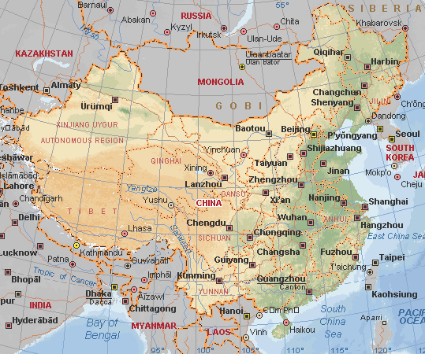
Location of Narada factories
Manufacturers Location

Slide 13
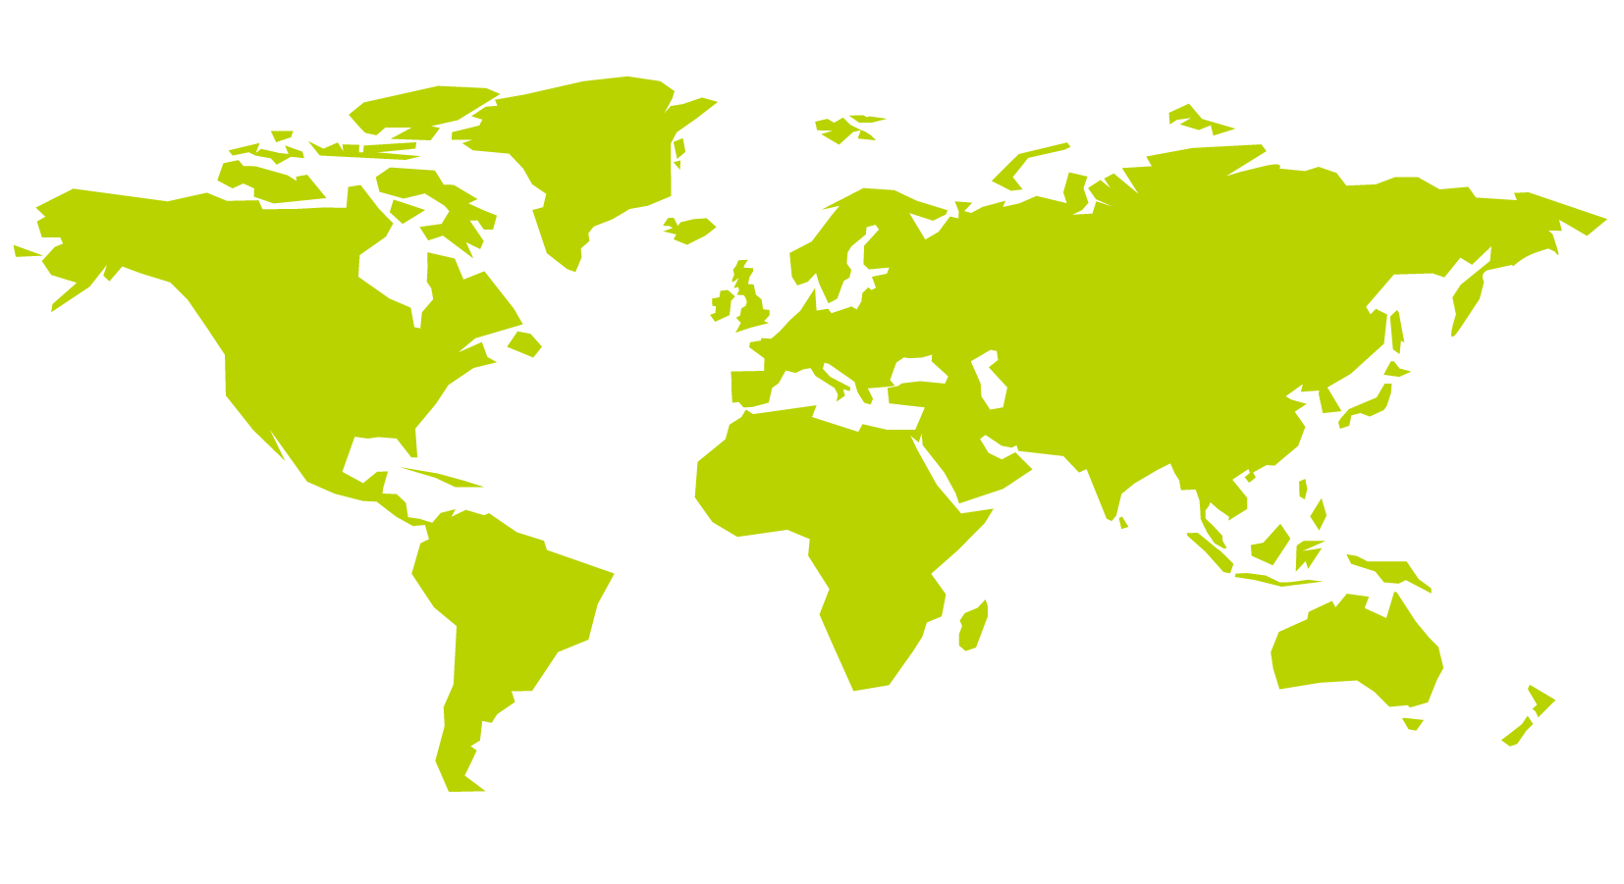



Narada global locations
-exported to more than 100 countries
  Narada Europe (UK) Ltd
  Russia –Tehnoliga
  Middle East - partners
North America
  USA – office in Boston
Global Headquarter
Narada China
India/Narada India
APAC Narada Asia Pacific Pte. Ltd
  Dartcom
  South America –
  office in Argentina
Narada subsidiary
Main Partner

Slide 14

What we can do? Global Service Function-Together with our parters
Project Consultancy and Training
Technical Evaluation
Installation service
Warranty Service & Logistic Support (RMA)
Fault Analysis Troubleshooting
Battery Maintenance Service
Battery Replacement Service
Battery Disposal Service

Slide 15
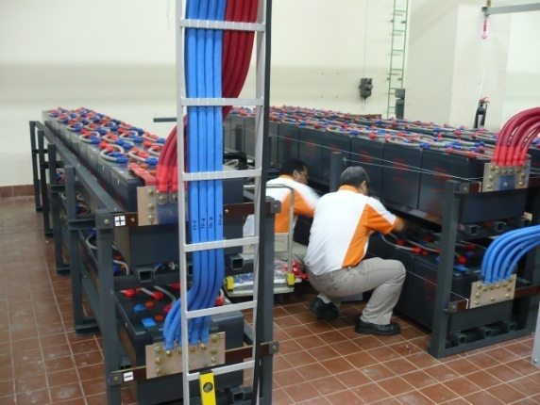
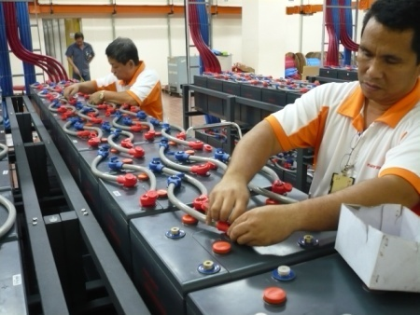
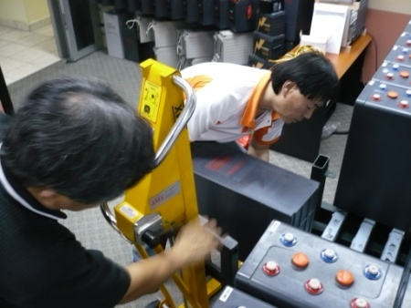
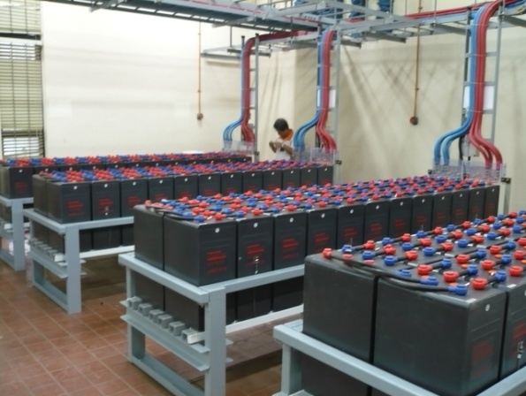
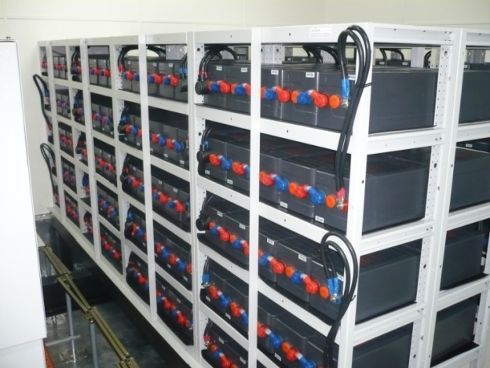
What we can do? Installation and Project Management
Project Installation
Engineering Solution

Slide 16
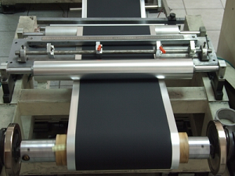
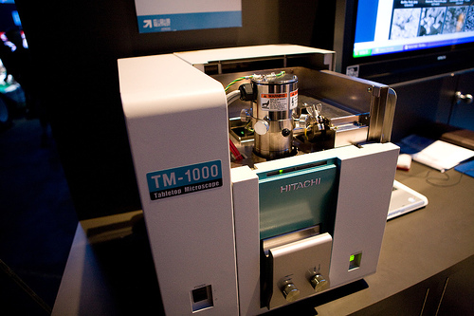
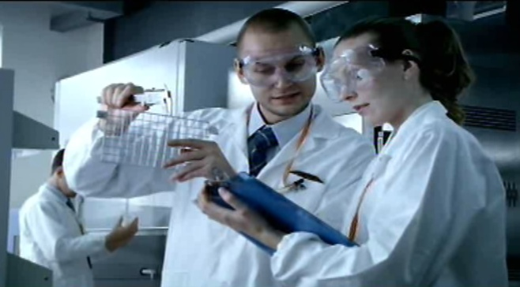
R&D ability
Narada R&D center; Academician Expert Workstation; Postdoctoral Research Workstation, National Approval Lab.
Narada Research Institute is consisted of Basic research branch, Lithium battery branch, VRLA branch, system integration branch.
Strong R&D team with head of academician, total research people 215, among whom is undergraduate/post degree, with which takes 13.9% of all employees.
Chief Scientist of Narada—Mr. Herbert K. Giess, who is chairman of IEC TC21 Secondary cells and batteries; Working group leader for the establishment of the IEC standard for VRLA Batteries IEC 60896-21 and 22/2003.
Notes:
16

Slide 17
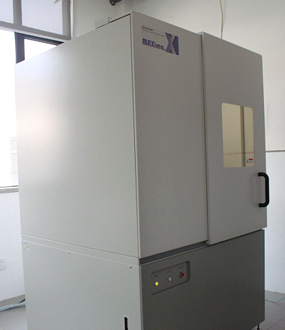
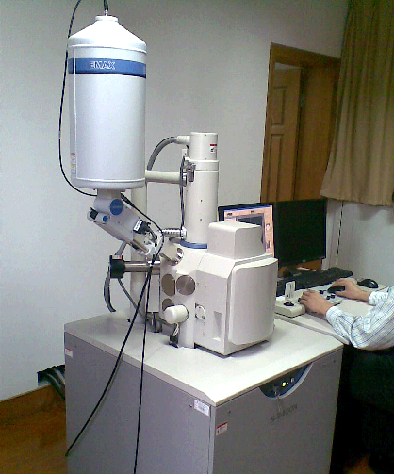
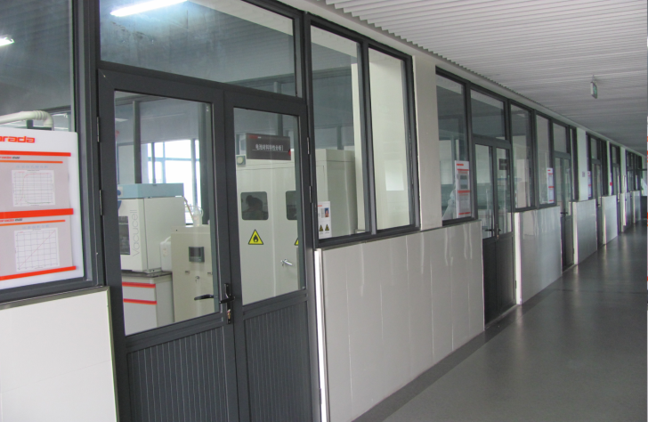
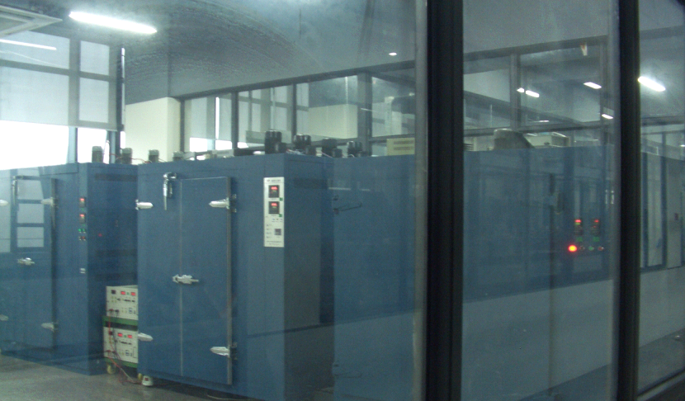
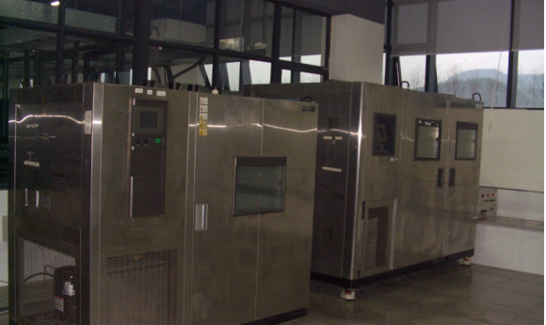
Why choose us? Advanced Lab
CNAS certified First-class lab
Advanced equipment – Over 10 Million RMB investment

Slide 18
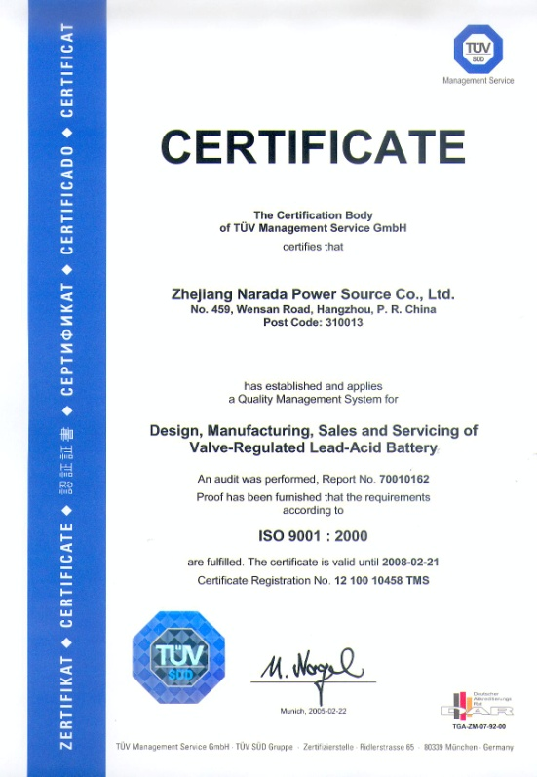
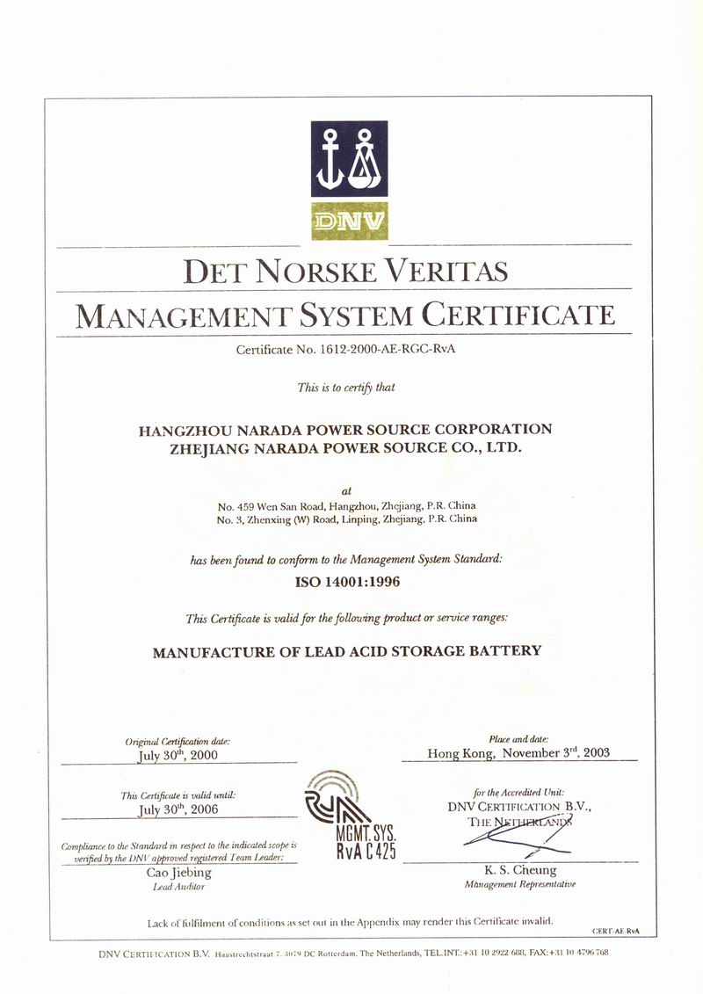
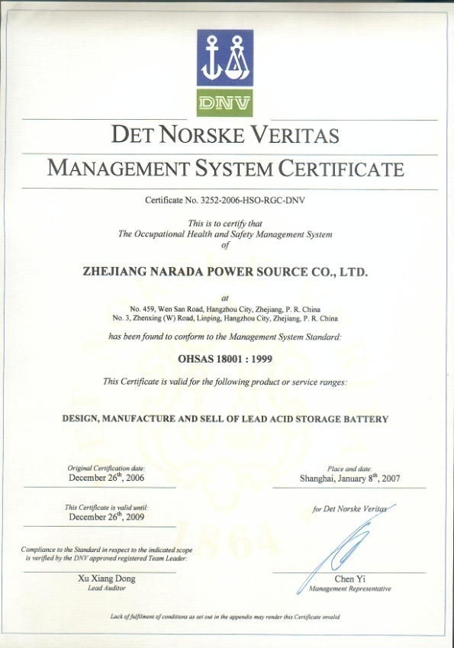
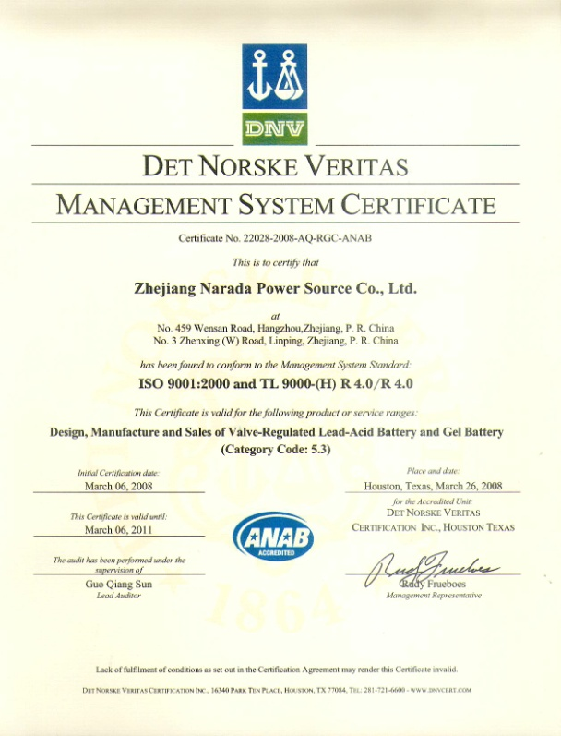
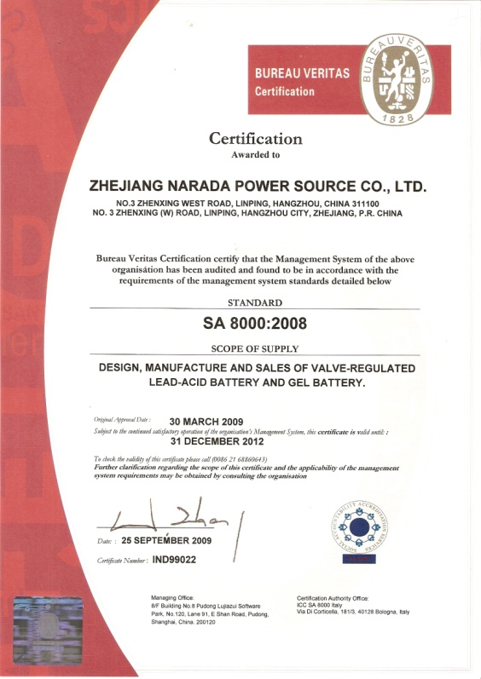
Why choose us? Premium Quality Assurance
ISO9001
by TUV
ISO14001
by DNV
OHSAS18001
by DNV
TL-9000
by DNV
SA8000
by BUREAU VERITAS
18
Notes:
18

Slide 19
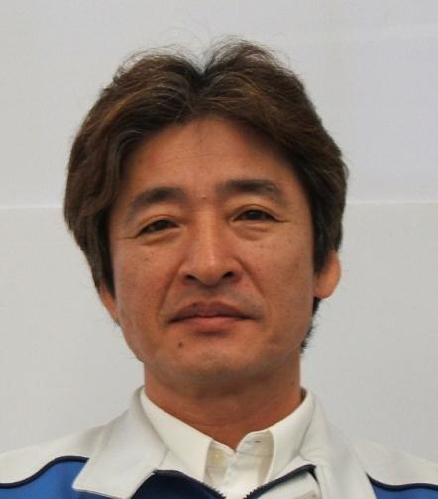

Why choose us? Premium quality management
Mr.HAGIMORI HAJIME
– Head of quality management
-- 42 years experience of quality management
in Toyota TPS system
-- NPS, Narada Production System
19
Notes:
19

Slide 20


Why choose us? Rich R&D Resource
  Total employee number: 2912
  134 Masters Graduates
  462 Graduates
  2214 Skilled workers
  102 Auxiliary person

Slide 21






How’s our performance? Widely accepted by Clients

Slide 22
















Widely accepted by Clients

Slide 23


















Widely accepted by Clients

Slide 24




















Widely accepted by Clients

Slide 25

















Widely accepted by Clients

Slide 26







How’s our performance? Widely accepted by Clients
26
Notes:
26

Slide 27
Operation philosophy
全球南都
创新南都
绿色南都
责任南都
Global reaching
Innovation
Green solutions
Social responsibility
Notes:
27

Slide 28

Your ideal global partner of
energy solutions.
stored energy solutions for a demanding world

